Slide 2
Objectives Overview
Differentiate between storage devices and storage media
Describe the characteristics of an internal hard disk including capacity, platters, read/write heads, cylinders, sectors and tracks, revolutions per minute, transfer rate, and access time
Discuss the purpose of network attached storage devices, external and removable hard disks, and hard disk controllers
Describe the various types of flash memory storage
See Page 351
for Detailed Objectives

Slide 3
Objectives Overview
Describe cloud storage and explain its advantages
Describe the characteristics of optical discs
Differentiate among various types of optical discs: CDs, archive discs and Picture CDs, DVDs, and Blu-ray Discs
Identify the uses of tape, magnetic stripe cards, smart cards, microfilm and microfiche, and enterprise storage
See Page 351
for Detailed Objectives

Slide 4
Storage
Storage holds data, instructions, and information for future use
A storage medium is the physical material on which a computer keeps data, instructions, and information
Pages 352 - 353

Slide 5
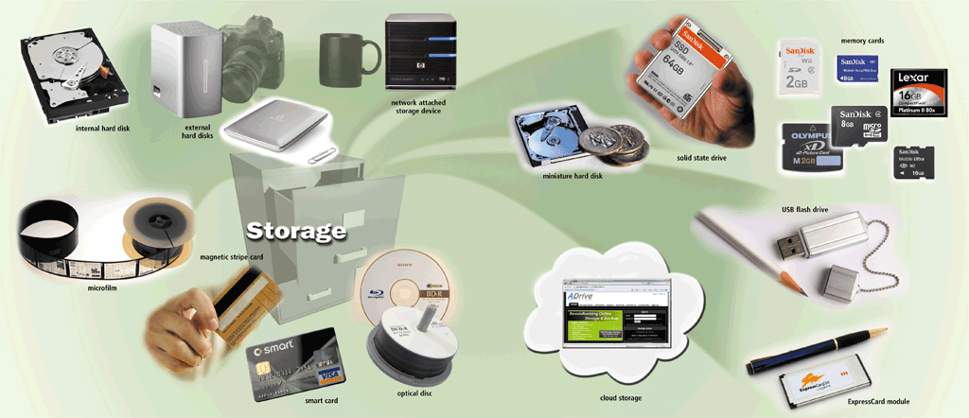
Storage
Pages 352 – 353
Figure 7-1

Slide 6
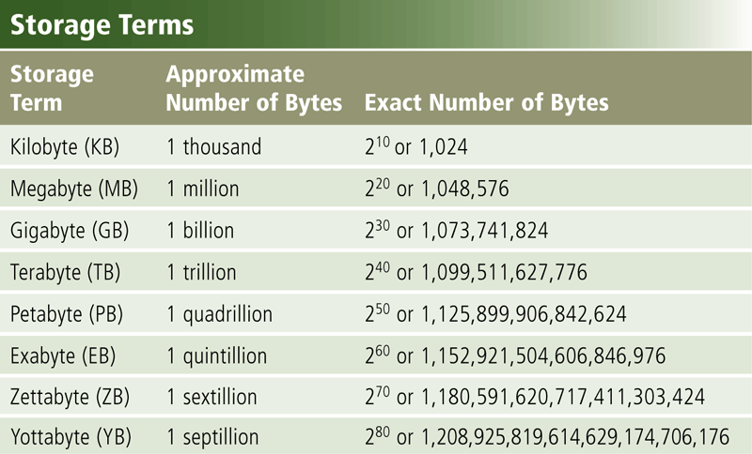
Storage
Capacity is the number of bytes a storage medium can hold
Page 354
Figure 7-2

Slide 7
Storage
A storage device is the computer hardware that records and/or retrieves items to and from storage media
Reading is the process of transferring items from a storage medium into memory
Writing is the process of transferring items from memory to a storage medium
Page 354

Slide 8
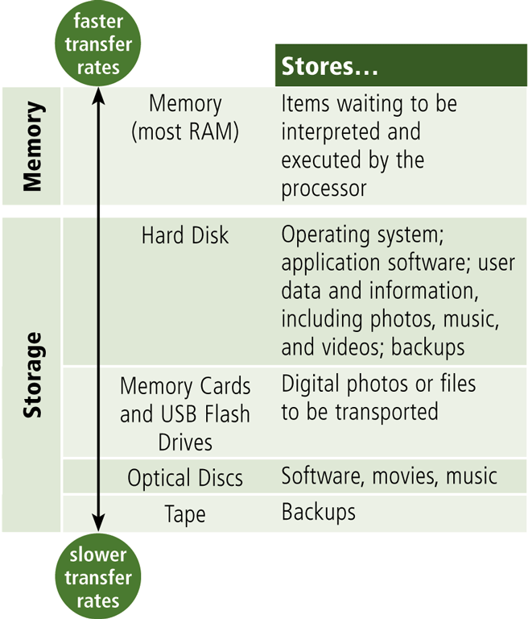
Storage
Access time measures:
The amount of time it takes a storage device to locate an item on a storage medium
The time required to deliver an item from memory to the processor
Page 355
Figure 7-4

Slide 9
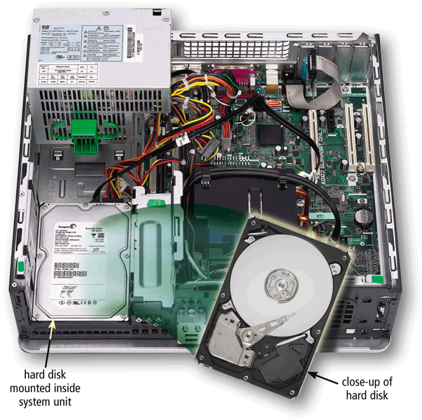
Hard Disks
A hard disk contains one or more inflexible, circular platters that use magnetic particles to store data, instructions, and information
Page 355
Figure 7-5

Slide 10
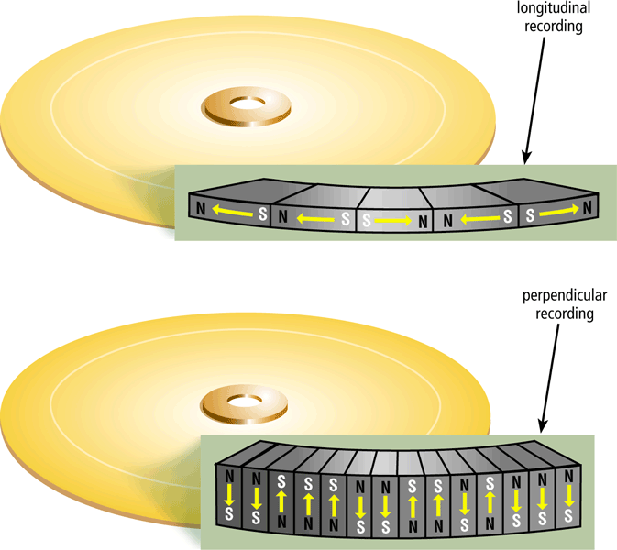
Hard Disks
Hard disks can store data using longitudinal recording or perpendicular recording
Page 356
Figure 7-6

Slide 11
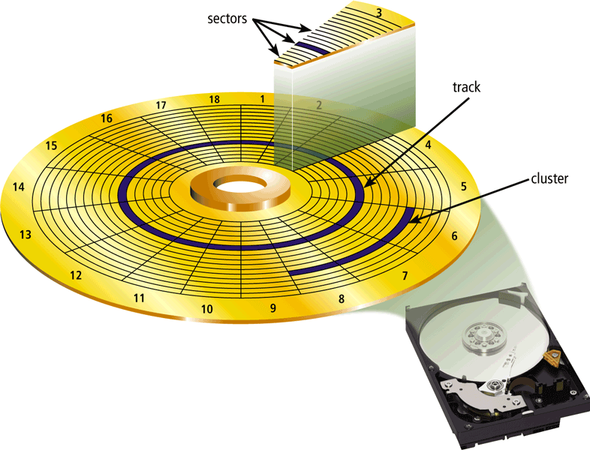
Hard Disks
Characteristics of a hard disk include:
Capacity
Platters
Read/Write Heads
Cylinders
Sectors and Tracks
Revolutions per Minute
Transfer Rate
Access Time
Page 357
Figure 7-8

Slide 12
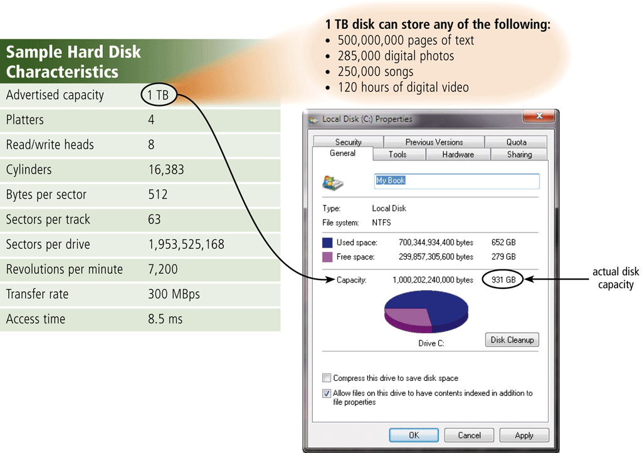
Hard Disks
Formatting is the process of dividing the disk into tracks and sectors so that the operating system can store and locate data and information on the disk
Page 357
Figure 7-7

Slide 13
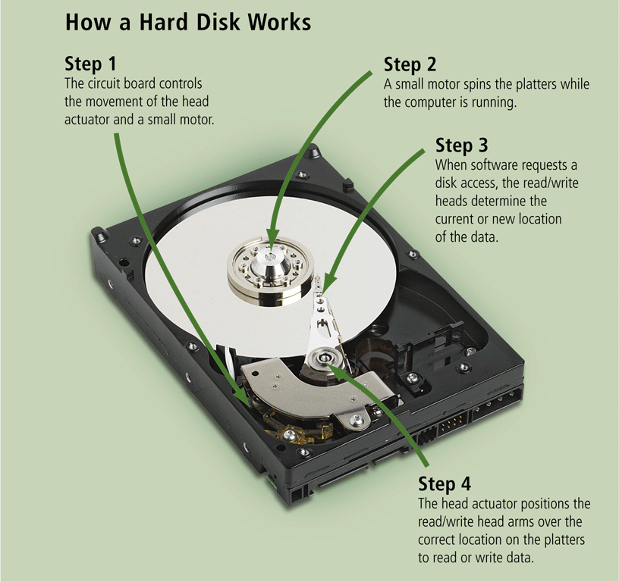
Hard Disks
Page 358
Figure 7-9

Slide 14
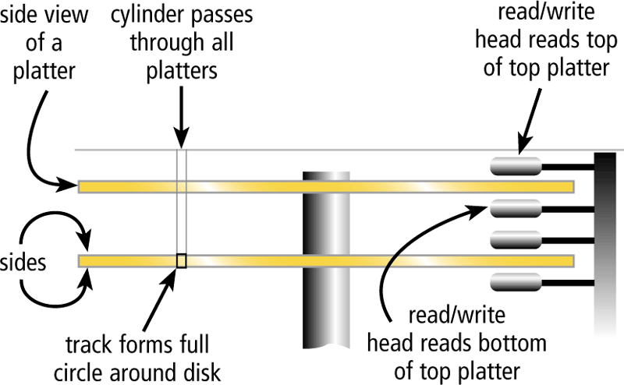
Hard Disks
The hard disk arms move the read/write head, which reads items and writes items in the drive
Location often is referred to by its cylinder
Page 358
Figure 7-10

Slide 15
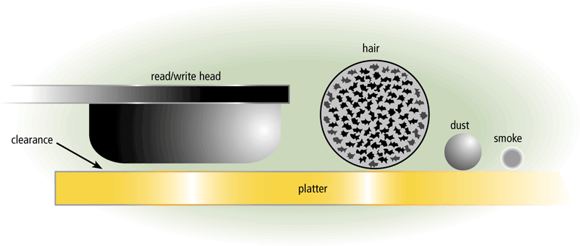
Hard Disks
A head crash occurs when a read/write head touches the surface of a platter
Always keep a backup of your hard disk
Pages 358 – 359
Figure 7-11

Slide 16
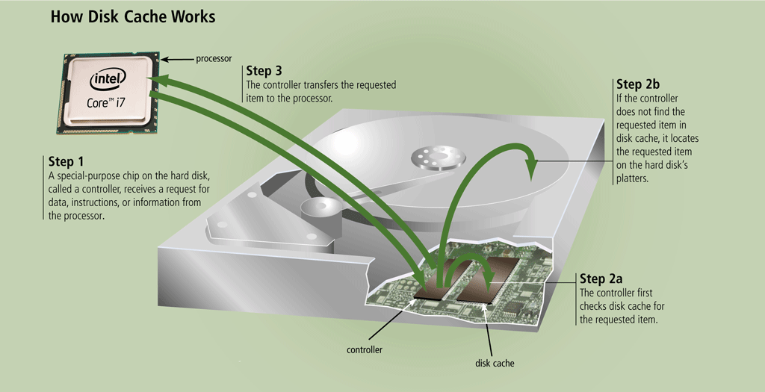
Hard Disks
Page 359
Figure 7-12

Slide 17
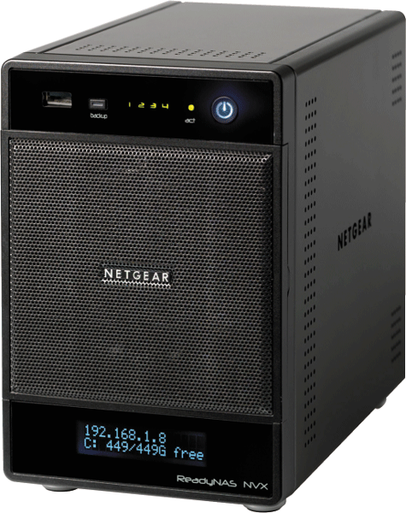
Hard Disks
RAID (redundant array of independent disks) is a group of two or more integrated hard disks
A network attached storage (NAS) device is a server connected to a network with the sole purpose of providing storage
Page 360
Figure 7-13

Slide 18
Hard Disks
An external hard disk is a separate free-standing hard disk that connects to your computer with a cable or wirelessly
A removable hard disk is a hard disk that you insert and remove from a drive
Internal and external hard disks are available in miniature sizes (miniature hard disks)
Pages 360 – 361
Figures 7-14 – 7-15

Slide 19
Hard Disks
A disk controller consists of a special-purpose chip and electronic circuits that control the transfer of data, instructions, and information from a disk to and from the system bus and other components of the computer
SATA
EIDE
SCSI
SAS
Pages 361 - 362

Slide 20
Flash Memory Storage
Flash memory chips are a type of solid state media and contain no moving parts
Solid state drives (SSDs) have several advantages over magnetic hard disks:
Faster access time
Faster transfer rates
Generate less heat and consume less power
Last longer
Pages 362 - 363

Slide 21
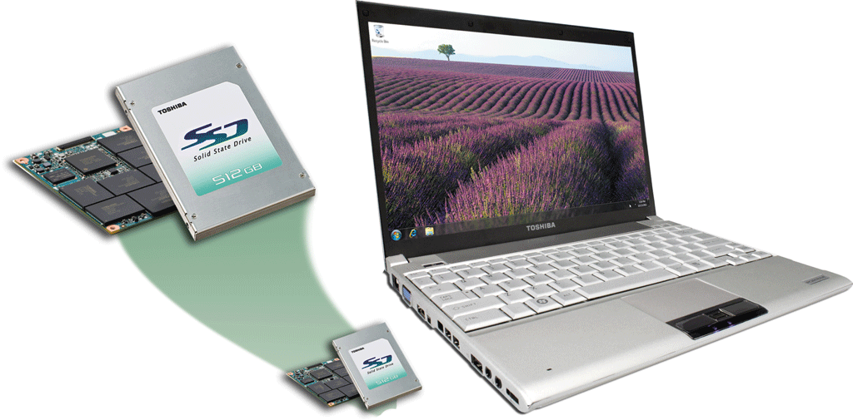
Flash Memory Storage
Page 363
Figure 7-17

Slide 22
Flash Memory Storage
A memory card is a removable flash memory device that you insert and remove from a slot in a computer, mobile device, or card reader/writer
CompactFlash (CF)
Secure Digital (SD)
Secure Digital High Capacity (SDHC)
microSD
microSDHC
xD Picture Card
Memory Stick
Memory Stick Micro (M2)
Page 364

Slide 23
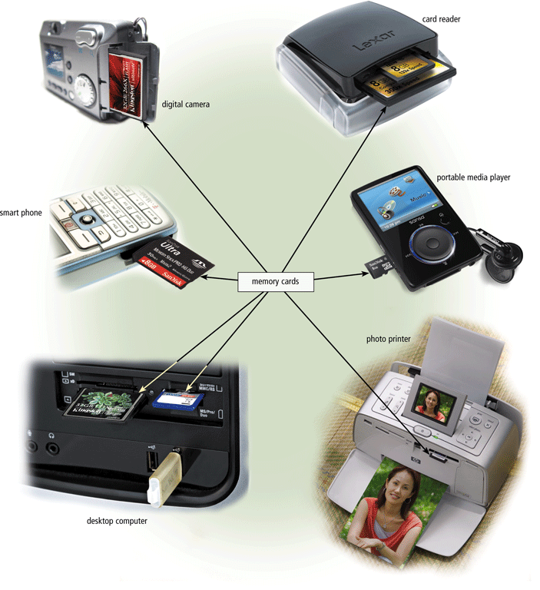
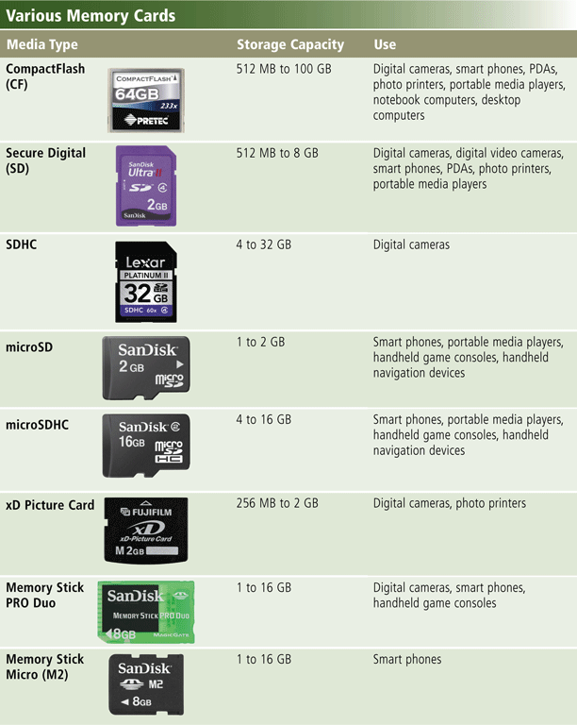
Flash Memory Storage
Pages 364 – 365
Figures 7-18 – 7-19

Slide 24
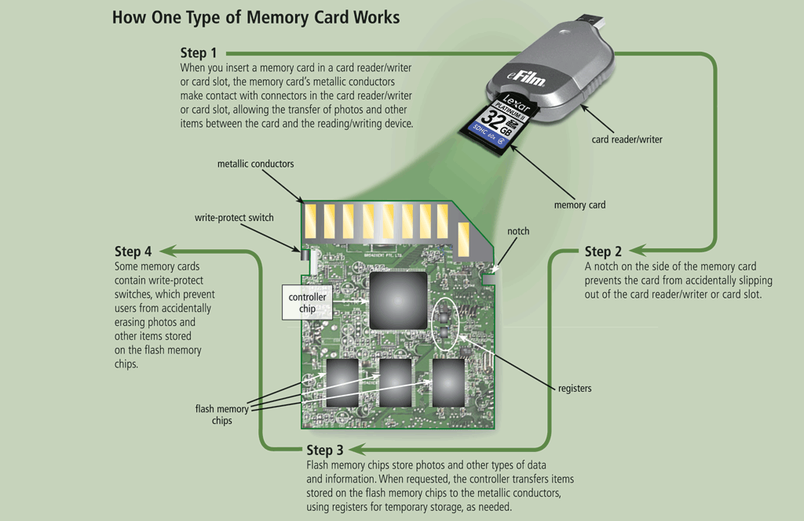
Flash Memory Storage
Page 366
Figure 7-20

Slide 25
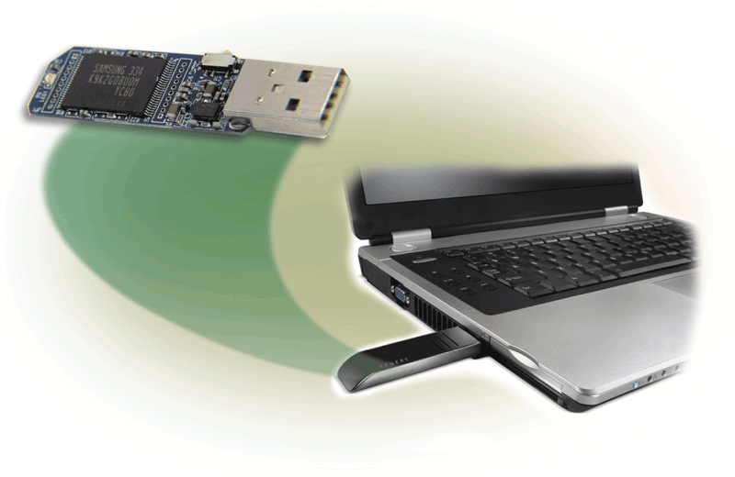
Flash Memory Storage
USB flash drives plug into a USB port on a computer or mobile device
Page 367
Figure 7-21

Slide 26
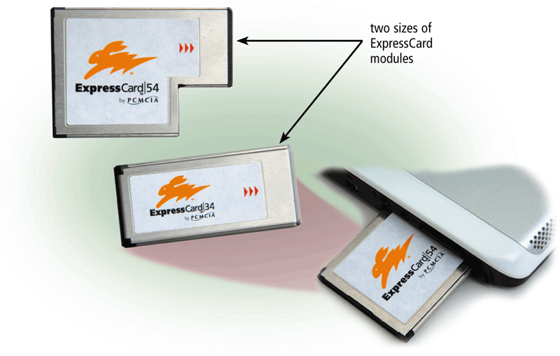
Flash Memory Storage
An ExpressCard module is a removable device that fits in an ExpressCard slot
Developed by the PCMCIA
Commonly used in notebook computers
Page 367
Figure 7-22

Slide 27
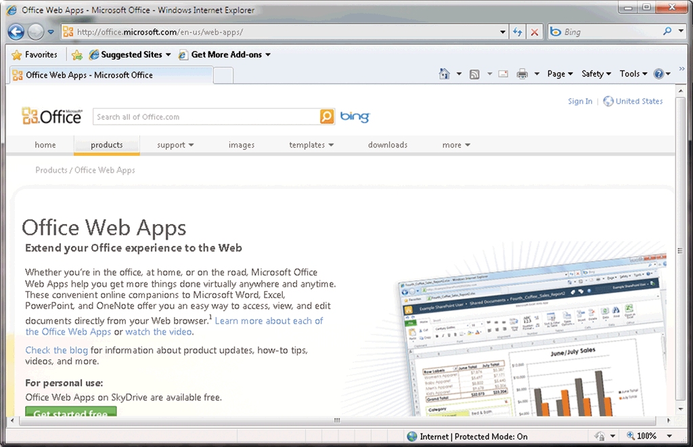
Cloud Storage
Cloud storage is an Internet service that provides storage to computer users
Page 368
Figure 7-23

Slide 28
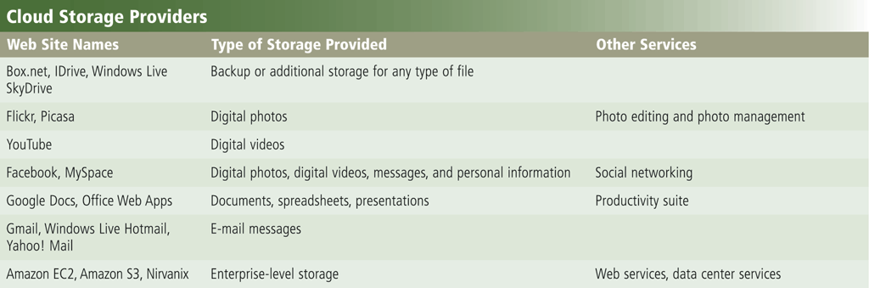
Cloud Storage
Page 368
Figure 7-24

Slide 29
Cloud Storage
Users subscribe to cloud storage for a variety of reasons:
Access files from any computer
Store large files instantaneously
Allow others to access their files
View time-critical data and images immediately
Store offsite backups
Provide data center functions
Page 369

Slide 30
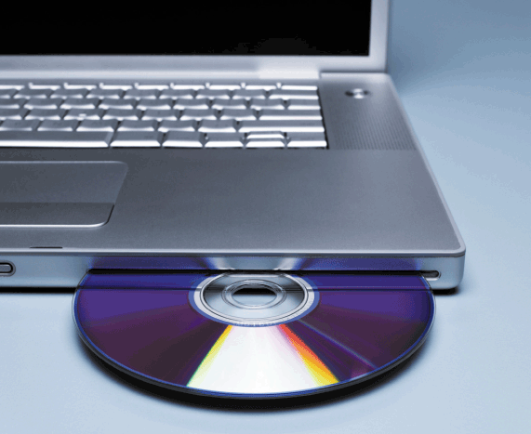
Optical Discs
An optical disc consists of a flat, round, portable disc made of metal, plastic, and lacquer that is written and read by a laser
Typically store software, data, digital photos, movies, and music
Read only vs. rewritable
Page 370
Figure 7-25

Slide 31
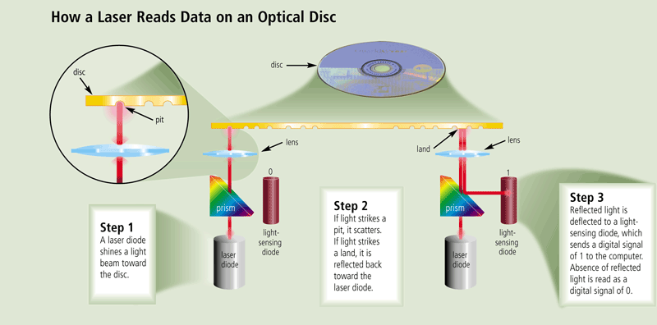
Optical Discs
Page 370
Figure 7-26

Slide 32
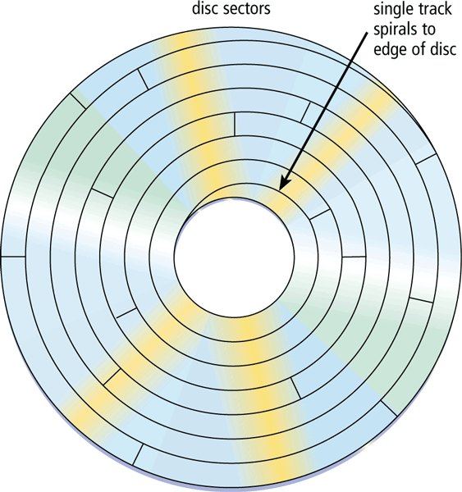
Optical Discs
Optical discs commonly store items in a single track that spirals from the center of the disc to the edge
Track is divided into evenly sized sectors
Page 371
Figure 7-27

Slide 33
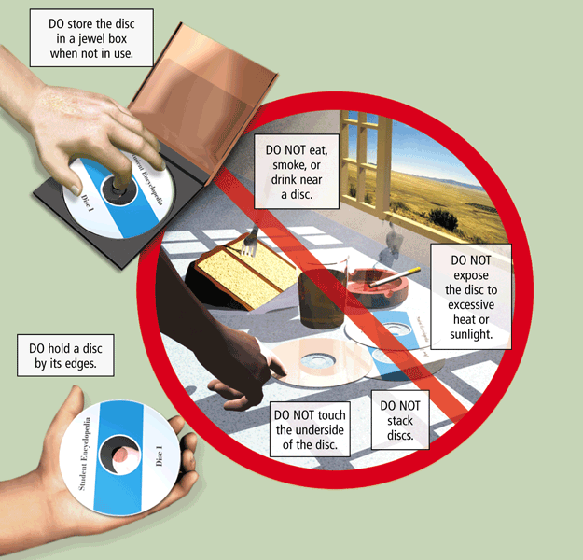
Optical Discs
Care of optical discs
Page 371
Figure 7-28

Slide 34
Optical Discs
A CD-ROM can be read from but not written to
Read from a CD-ROM drive or CD-ROM player
A CD-R is a multisession optical disc on which users can write, but not erase
A CD-RW is an erasable multisession disc
Must have a CD-RW drive
Pages 372 – 373
Figure 7-29

Slide 35
Optical Discs
Archive disc
Stores photos from an online photo center
Picture CD
Resolution usually is 7200 pixels per photo
Cost is determined by the number of photos being stored
Single-session CD-ROM that stores digital versions of film
Typically uses a 1024 x 1536 resolution
Many photo centers offer Picture CD services
Page 374

Slide 36
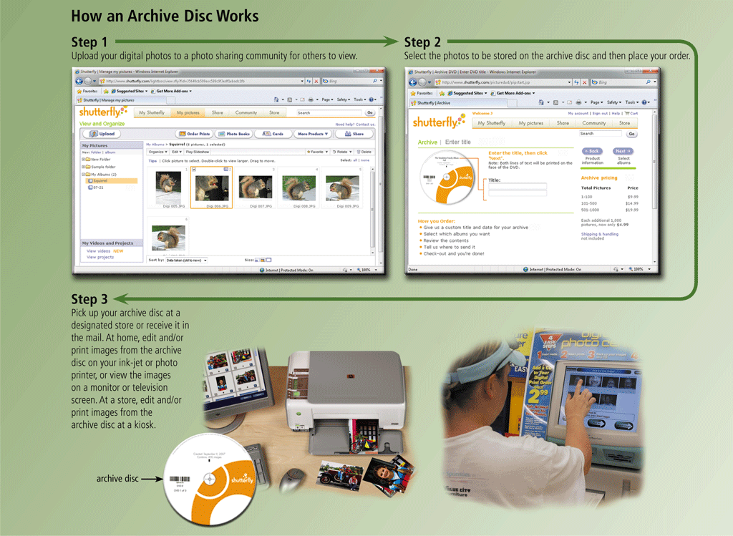
Optical Discs
Page 374
Figure 7-31

Slide 37
Optical Discs
A DVD-ROM is a high-capacity optical disc on which users can read but not write or erase
Requires a DVD-ROM drive
A Blu-ray Disc-ROM (BD-ROM) has a storage capacity of 100 GB
DVD-RW, DVD+RW, and DVD+RAM are high-capacity rewritable DVD formats
Pages 375 – 376
Figure 7-29

Slide 38
Other Types of Storage
Tape
Magnetic stripe cards and smart cards
Microfilm and microfiche
Enterprise storage
Page 376

Slide 39
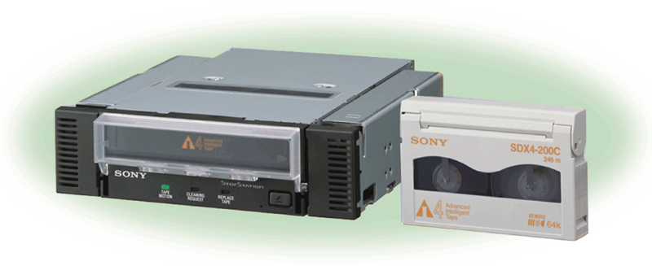
Other Types of Storage
Tape is a magnetically coated ribbon of plastic capable of storing large amounts of data and information
A tape drive reads and writes data and information on a tape
Page 376
Figure 7-35

Slide 40
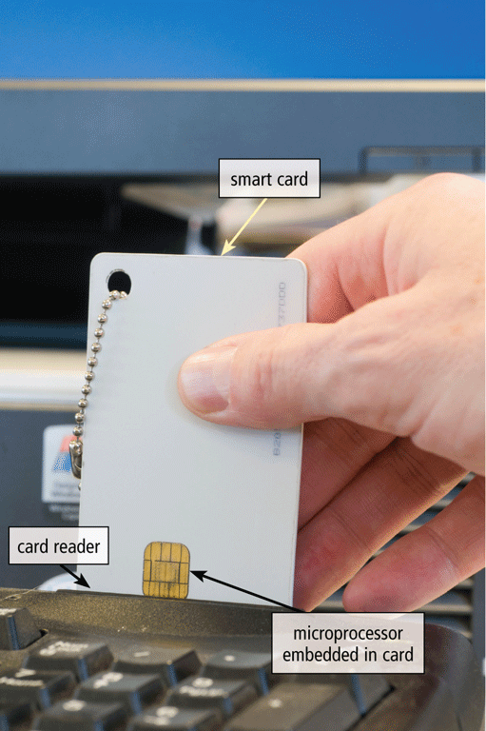
Other Types of Storage
A magnetic stripe card contains a magnetic stripe that stores information
A smart card stores data on a thin microprocessor embedded in the card
Page 377
Figure 7-36

Slide 41
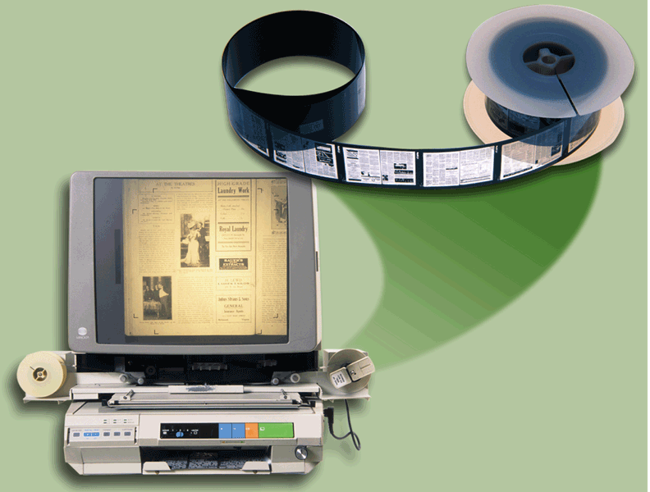
Other Types of Storage
Microfilm and microfiche store microscopic images of documents on a roll or sheet film
Page 378
Figure 7-37

Slide 42
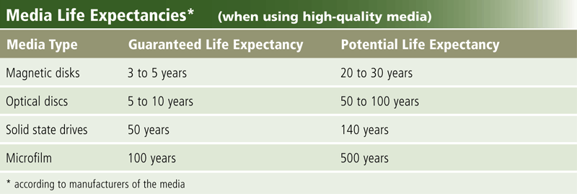
Other Types of Storage
Page 378
Figure 7-38

Slide 43
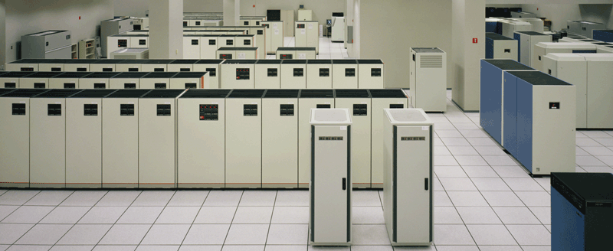
Other Types of Storage
Enterprise storage stores huge volumes of data and information for large businesses
Uses special hardware for heavy use, maximum availability, and maximum efficiency
Page 379
Figure 7-39

Slide 44
Putting It All Together
Home user
• 500 GB hard disk
• Cloud storage
• Optical disc drive
• Card reader/writer
• USB flash drive
Small Office/Home Office user
• 1 TB hard disk
• Cloud storage
• Optical disc drive
• External hard disk for backup
• USB flash drive
Mobile
• 250 GB hard disk
• Cloud storage
• Optical disc drive
• Card reader/writer
• Portable hard disk for backup
• USB flash drive
Page 380
Figure 7-40

Slide 45
Putting It All Together
Power User
• 2.5 TB hard disk
• Cloud storage
• Optical disc drive
• Portable hard disk for backup
• USB flash drive
Enterprise User (desktop computer)
• 1 TB hard disk
• Optical disc drive
• Smart card reader
• Tape drive
• USB flash drive
Enterprise User (server or mainframe)
• Network storage server
• 40 TB hard disk system
• Optical disc server
• Microfilm or microfiche
Page 380
Figure 7-40

Slide 46
Summary
Various storage media and storage devices
Internal hard disks, external and removable hard disks, solid state drives, memory cards, USB flash drives, ExpressCard modules, cloud storage, CDs, DVDs, and Blu-ray Discs, tape, smart cards, and microfilm and microfiche
Page 381

Slide 47
Chapter 7 Complete

